Slide 1
Topics (Part 1)
Personal Management
Introduction
Definition
Objectives
Characteristics
Functions and Principles
Recruitment and Training Methods

Slide 2
Personnel Management
It is one of the specialized functions necessary for the effective utilization of human resources (promoting and stimulating every employee)
Defined as “that part of the total management of an organisation which specifically deals with human resources in respect of:
Their procurement
Their development in terms of skills, knowledge, attitude
Their motivation towards the attainment of organizational objectives by creating and maintaining an organisational climate conductive to such development.

Slide 3
Objectives
Aims at getting the best out of people by winning and maintaining their whole hearted collaboration.
To attain maximum individual development, desirable work atmosphere and inter personnel relations etc.
Understanding of people at work
Building up of morale and motivation among workers.
Providing better service to the society and distributing profits fairly among the personnel in the enterprise.

Slide 4
Principles of Personnel Management
Principle of maximum industrial development:- Workers are able to fulfill the objectives of an organisation with min cost and their developed ability, cleverness, productivity and efficiency could be used for the objective.
Principle of scientific selection:- Selecting the right person to do the right job.
Principle of high morale:- It helps in increasing their intension to do work.
Principle of Dignity of labour:- Workers should feel proud of their work.
Principle of team spirit: They must have a sense of co operation, unity and mutual trust.

Slide 5
Principles of Personnel Management
Principle of effective communication:- A medium of effective communication between the management and workers should have to be maintained.
Principle of joint management:- Profit must be shared with workers which increases mutual faith and friendship among them.
Principle of fair reward:- Proper compensation should be given for their work, which helps in maintaining industrial peace.
Principle of effective utilization of human resources
Principle of contribution of national prosperity:- Develop a sense in labour that success of the organisation is the success of economic development of the nation.

Slide 6
Functions/Scope
It involves obtaining and maintaining an efficient work force as a means of achieving profitable goods and services.
Development of personnel policy:- to discharge duties & responsibilities by managers
Manpower planning
Recruitment and selection of manpower
Analysis, description and valuation of work
Compensation and schemes of appraisal of work, also informing the employees about their accomplishment and failures to facilitate development.

Slide 7
Functions/Scope
Keeping records of personnel
Welfare and safety programmes
Training and development of manpower
Wages and salary administration
Collective bargaining (negotiations with trade union)
Employee grievance handling
Promotion, transfers and retirement of employees.

Slide 8
Functions of Human Resources Management
Procurement
Training and Development
Compensation
Integration, and
Maintenance.

Slide 9
1. Procurement
Procurement is concerned with the obtaining of the proper quantity and quality of workforce necessary to accomplish objectives and functions of an organization.
It includes the determination of human resources requirements and their recruitment and selection.

Slide 10
Recruitment
Recruitment is developing a pool of job candidates in line with the human resource plan.
Candidates are usually located through newspaper and professional journal advertisements, employment agencies, word of mouth and visits to college and university campuses.

Slide 11
Selection
Selection is the mutual process whereby the organization decides whether or not to make a job offer and the candidate decides whether or not to accept it.
The standard hiring sequence is the seven-step procedure.
In practice, however, the actual selection process varies with different organizations and between levels in the same organization.

Slide 12
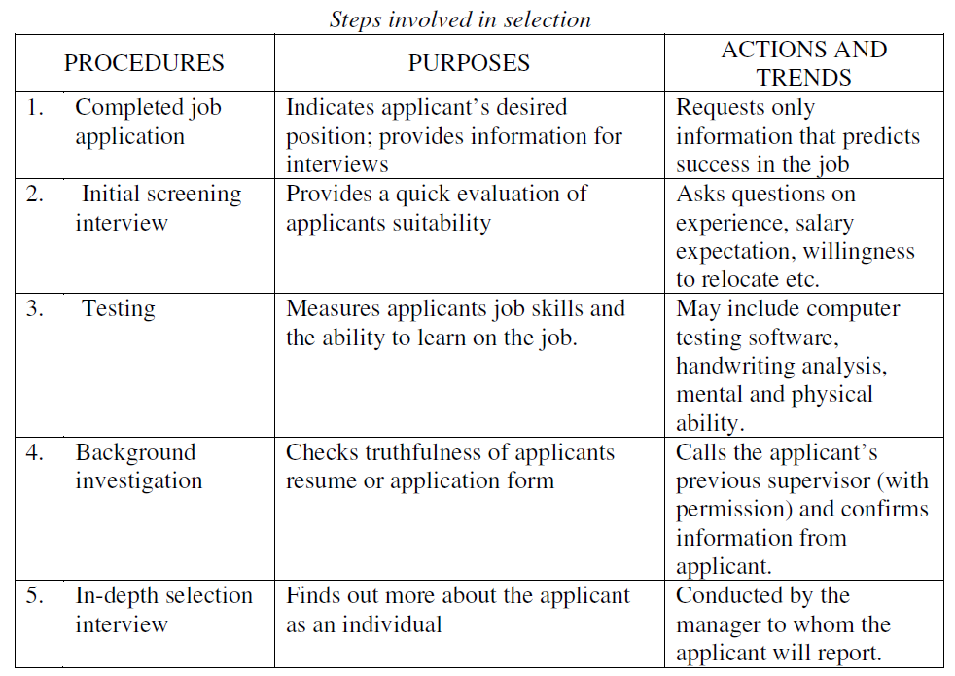

Slide 13
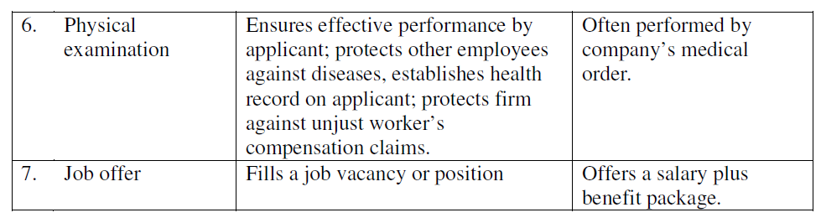

Slide 14
2. Training and Development
The quality of employees and their development through training and education are major factors in determining long-term profitability of a concern.
Both managers and non-managers may benefit from training and development programs, but the mix of experiences is likely to vary.
Non – managers are often trained in the technical skills, whereas the focus of training managers will be in developing conceptual and human relations skill.

Slide 15
2. Training and Development
Since training involves time, effort and money it is important to be very careful while designing a training program.
The objectives and need for training should be clearly identified and the method or type of training should be chosen according to the needs and objectives established. Two commonly methods of training are:
On-the-job training methods
Off-the-job training methods

Slide 16
On-the-job training methods
On-the-job methods enable the trainees to learn as they contribute to the aims of the enterprise. The following are some of the On-the-job training methods.
Job rotation, in which the employee, over a period of time, works on a series of jobs, there by learning a broad variety of skills.
Internship in which job training is combined with related class room instructions.
Apprenticeship in which the employee is trained under the guidance of a highly skilled co-worker.

Slide 17
On-the-job training methods
Coaching is the training of an employee by his/her immediate superior. The superior guides his sub-ordinates and gives him/her job instructions. The superior points out the mistakes and gives suggestions for improvement.
Planned work Activities, in which trainees are given work assignments to develop their experience and ability. Trainees may be asked to head a task force or participate in an important committee meeting. Such experiences help them to understand how organizations operate and also improve their human relations skill.

Slide 18
Off-the-job training methods
Off the job training takes place outside the workplace but attempts to simulate actual working conditions. This type of training includes:
Vestibule training - Employees train on the actual equipment and in a realistic job setting, but in a room different from the one in which they will be working. The objective is to avoid the on the job pressures that might interfere with the learning process.

Slide 19
Off-the-job training methods
Audiovisual methods such as television, videotapes and films are employed for providing real world conditions and situations in a short time. One advantage is that the presentation is the same no matter how many times it is played. This is not true with lectures, which can change as the speaker is changed or can be influenced by outside constraints. The major flaw with the audiovisual method is that it does not allow for questions and interactions with the speaker, nor does it allow for changes in the presentation for different audiences.

Slide 20
Off-the-job training methods
Computer-Assisted Instruction (CAI) can be employed which can reduce the time needed for training and also can provide more help for individual trainees. They also allow the trainee to learn at his or her own space.
Classroom Instructions- In this approach specialist from inside or outside the organization teach trainees a particular subject. Classroom instruction is often supplemented with exercises.
Planned Readings, involves reading of relevant literature. The training department may aid a manger by providing a list of valuable books. This is essentially a self-development

Slide 21
3. Compensation
Compensation provides for the adequate and equitable remuneration of the work force in order to secure their best contribution to the achievement of the organization's goals.
Fixing wage rates for different categories of employees is an important task of management.
The employees are not only concerned with wages received but also concerned with the level of wages received by same level of employees in similar organizations.
The relative wage rules should be fixed carefully, because they have implications for promotion, transfer, seniority and other important personnel matters.

Slide 22
4. Integration
The basic objective of human resource management is to secure maximum performance from the employees. This can be accomplished only through better integration between the organization and its employees.
An effective integration between the organization and its employees depends on three things, namely motivation, leadership and communication.
In recent years the human relation exponents have revolutionized the ways and means of dealing with employees for greater performance and productivity.
Hence, managerial job has become more complicated and challenging.

Slide 23
5. Maintenance
This function of personnel management is concerned with maintaining the abilities and attitudes already created and improving the conditions established through health safety, welfare and benefits programs

Slide 24
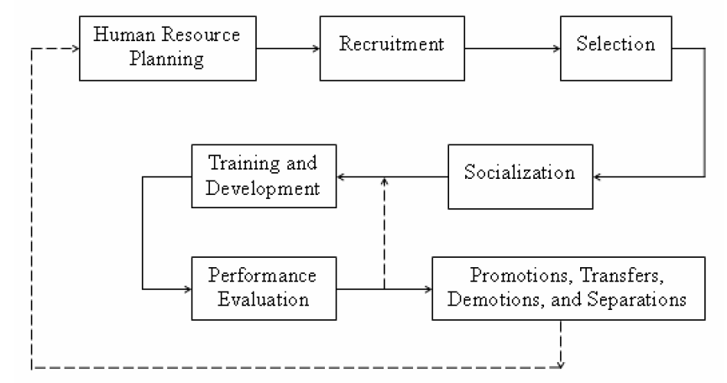
HRM process in organizations

Slide 25
Wages and Incentives
Wage may be defined as payment for the use of labour and it includes money as well as non-money payments.

Slide 26
Wages and Incentives
Wage payment plans or systems can broadly be classified into two categories:
Time rate system or non-incentive system, wherein the earnings of the worker is proportional to the time spent by him on the work. This system of wage payment is independent upon the quantity of output produced by the worker. If R is the wage rate per hour and T is the number of hours of work, then the earnings of the worker, E can be expressed as: E = RT
Incentive system wherein the earnings of the worker is proportional to the quantity of output produced.

Slide 27
Incentive system
Straight Piece Rate System - It is the simplest method of payment and under this method payment is made according to the number of units produced at a fixed rate per unit.

Slide 28
Straight Piece Rate System - Advantages
Efficiency is recognized
Motivates the workers
Computation of labour cost is easy
Less Idle Time
Helps to boost production

Slide 29
Straight Piece Rate System - Disadvantages
Quality suffers as the emphasis is on quantity
More scrap and defective Work
Damage to Tools and Equipment
No Guaranteed Wages
Uncertainty in Income
Trade Unions Oppose the System
Enforced idleness because of power failure, material shortage, etc. can badly affect the earnings of a worker

Slide 30
Incentive system
Straight Piece Rate System with a Guaranteed Wage - Under this system, a standard output is set by the management and a corresponding minimum guaranteed wage is also fixed.
If a worker produces less than (or equal to) the standard output he will be getting the minimum guaranteed wage.
On the other hand, if a worker exceeds this standard, he will be paid in accordance with the straight piece rate system.

Slide 31
Straight Piece Rate System with a Guaranteed Wage - Advantages
Provides a guaranteed minimum wage.
The minimum wage takes care of the enforced idleness beyond the control of workers.

Slide 32
Straight Piece Rate System with a Guaranteed Wage - Disadvantages
The system does not offer sufficient incentive for a worker who exceeds the set output standard.

Slide 33
Incentive system
Differential Piece Rate System - In this system, up to a certain production level, which is the standard output, a piece rate is given. A worker who exceeds this output will be paid at a higher piece rate.
However, this system of wage payment does not guarantee minimum base wage.

Slide 34
Differential Piece Rate System - Advantages
Provides incentives to efficient worker
Penalizes inefficient worker
Focuses on high production rate
Simple and easy to implement

Slide 35
Differential Piece Rate System - Disadvantages
Minimum wage is not assured.
No consideration for the machine failure, power failure, etc.
Over emphasis on high production rate
There are chances that quality of work may suffer

Slide 36
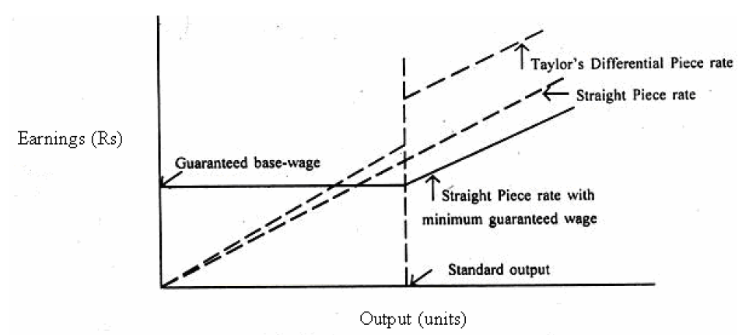
Incentive system

Slide 37
Topics (Part 2)
Marketing
Definition
Market segmentation
Consumer market vs Industrial markets
Pricing
Sales
Distribution
advertisements

Slide 38
Definition
Marketing is the economic process by which goods and services are exchanged between the producer and the consumer and their values determined in terms of money.
It’s a total system of interacting business designed to plan, promote and distribute need-satisfying products and services to existing and potential consumers.
Marketing starts with the identification of a specific need on the part of the consumer and ends with the satisfaction of that need.

Slide 39
Marketing Management
Marketing management is one of the main management disciplines, encompassing all the strategic planning, operations, activities, and processes involved in achieving organizational goals by delivering value to customers.
Marketing management focuses on satisfying customer requirements by identifying needs and wants, and developing products and services to meet them.

Slide 40
Concept of Marketing Vs Selling
The marketing concept gives importance to consumers and the concept holds that the key to achieving organizational goal consists in determining the needs and wants of customers and delivering the desired satisfaction.
The selling concept is product-oriented and the concept holds that the consumers normally will not buy enough of the organizations products and therefore efforts must be made to force the customers to buy the products.

Slide 41
Selling | Marketing
Product Oriented | Customer oriented
Emphasis on company (seller) needs | Emphasis on customer’s need
Company oriented selling efforts | Market oriented selling efforts
Goods are already produced and then sold at profit | Customer demand determines production
Selling aims at short term objectives | Aims at long term objectives

Slide 42
Marketing System
Input :- Product, price, place and promotion (Marketing Mix).
Processor:- business organisation.
Output:- Sale of goods
Controller
Objective:- Profit/Customer satisfaction

Slide 43
Market Segmentation
Market segmentation is defined as “ taking the total heterogeneous market for a product and dividing it into several segments, each of which tends to be homogeneous in full significant aspects.
It consist of grouping of consumers according to such characteristics as income, age, taste for a product etc.

Slide 44
Types/Methods of Market Segmentation
Geographic Segmentation:- Based on region, continent, country, climate of area etc.
2. Demographic Segmentation:- Based on age of customers, family size, religion, community, occupation etc.
3. Psychographic Segmentation:- Based on personality types, lifestyles etc.

Slide 45
Types/Methods of Market Segmentation
Buyer behaviour Segmentation:- Different customer groups expect different benefits from the same product and as such their motivations in owing it and their behaviour in buying it will be different.
5. Volume Segmentation:- Based on quantity of purchase or the potential quantity of purchase.

Slide 46
Marketing Mix
The marketing mix refers to the blend of four controllable variables that companies use to influence the market responses – product, pricing, promotion and channels of distribution. Marketing mixes used by various organizations may vary depending upon the strategies and tactics adopted by them.

Slide 47
Product
Prior to the adoption of the marketing concept philosophy the major focus was on the technological or engineering dimensions of a product.
Today products are designed and developed by taking into consideration the needs and demands of the customers.
From the marketing view point an optimal product design would be one that will bring enough profits to the company and at the same time meets the needs and expectations of the customer.
Aesthetic and functional qualities of the product - any change in design should be properly planned and thought off before implementation.

Slide 48
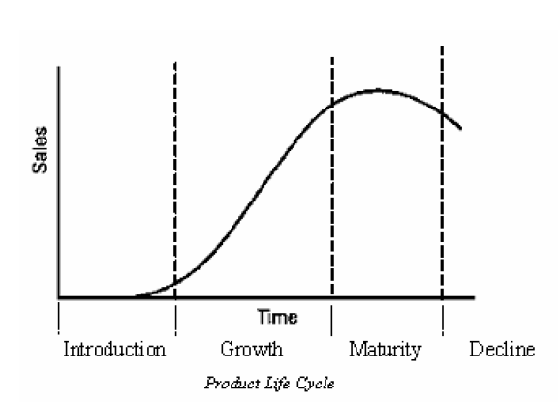
Product Life Cycle

Slide 49
Pricing
Price refers to the exchange value of a product or a service.
One of the most important tasks of a marketing manager is pricing.
Unless the product is priced properly, all other elements of marketing mix may be rendered ineffective.

Slide 50
The key factors to be considered in pricing are:
Nature and extent of consumer demand
Total cost associated with the product
Legal aspects
Prices for similar products offered by competing firms
General economic conditions
Type of customers
Method of promotion
Distribution channels
Life cycle of the product
Profit considerations

Slide 51
Pricing Methods
Cost Plus Approach
The Market or Demand Approach

Slide 52
Pricing Methods
Cost Plus Approach:- this approach is one of the commonly used methods of pricing. In this method total cost associated with production, selling and distribution are added with the desired profit.
i.e. Product Price = Fixed Cost per Unit + Variable Cost per Unit + Profit margin

Slide 53
Pricing Methods
The Market or Demand Approach:- In this method of pricing, prices are not based on the total cost but allow the market forces (supply and demand) to determine the product price.

Slide 54
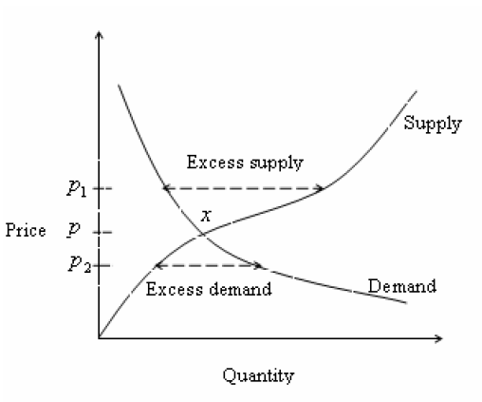
The Market or Demand Approach

Slide 55
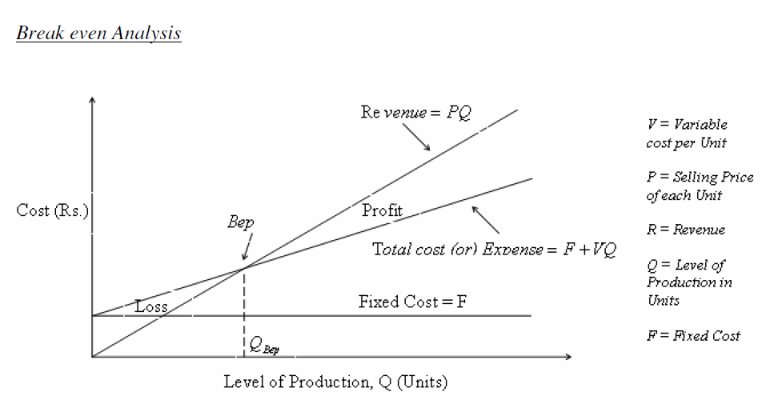
Break Even Analysis

Slide 56
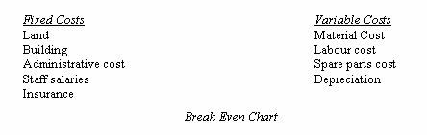
Break Even Analysis

Slide 57
Promotion
Promotion is communication to the potential buyer and includes all those activities that will facilitate the sale of a good or service or acceptance of an idea. Three important types of promotion are advertising, personnel selling and sales promotion.

Slide 58
Advertising
Advertising is any form of paid non-personal presentation of ideas, goods or services for the purpose of inducing people to buy In short, “advertising is salesmanship without a personal salesman”.

Slide 59
Objectives
Providing general information about the existence of the product.
Providing technical information about its functional characteristics or utilitarian purposes.
Drawing the customer’s attention to those attributes of the product which he wants.
Winning undecided customers by exhibiting possible attractions (such as colour, design, novelty and price) that may persuade him to prefer the product to one offered by competitors.
Creating demand among a passive population of customers.
Educating the customer, or telling him what he should want.

Slide 60
Advertising Medium
An advertising medium is a carrier of information to be advertised. The commonly used media for advertising are as follows:
Newspapers
Magazines
Catalogues and leaflets
Radio
Television
Internet
Public transports such as buses, trains, etc.
Outdoor billboards (hoardings) such as on highways
Slides and film shows in cinemas

Slide 61
Personal Selling
Personal selling refers to oral presentation to one or more customers in a face to face situation to persuade them to purchase the product. It involves two way communications between salesman and buyers.

Slide 62
Personal Selling
Some of the positive aspects associated with personal selling are as follows:
The salesman act as a consultant to the customers
The salesman can adjust his message and presentation according to the needs of the situation and type of customer
The salesman can clear the doubts of the customers related with the use or functional aspects of the product
Personal selling develops social relations with customers and builds reputation of the company
Quick feed back can be obtained through personnel selling

Slide 63
Sales promotion
All the activities that go into the development of sales or those that are intended to raise the demand level for a product very quickly can be termed as sales promotion.
The idea behind sales promotion is to bring the name of product and that of the manufacturer constantly before wholesalers, retailers and the consumers in order to stimulate the interest in the product.

Slide 64
Methods of Sales Promotion
Consumer Promotion: Persuading consumers to buy; these include samples, money refund offers, prices-off, trading stamps, contest and competitions, etc.
Trade Promotion: Giving incentives to distributors and others to hold stocks of company products.
Sales Force Promotion: Offering bonuses, contests etc. for the salesmen.
Good Public Relations: Developing goodwill among general public and boosting sales.

Slide 65
Methods of Sales Promotion
Display: Displays at the point of sale, using posters, banners, placards and leaflets, to attract the customers’ attention to the product.
Good Customer Relations: Good customer relations are basically the result of the past transactions with the company.
Speedy handling of complaint, assistance in emergencies, abiding by announced policies, etc. all develops good customer relations and increase future sale of company products.
Product exhibitions, demonstrations, and conferences.
Latest product styling and appealing product packaging catch the eye of the consumer and develop sales volume.

Slide 66
Physical Distribution/Channels of Distribution
A channel of distribution is the route that the product follows in its passage from the producer to the consumer.
Factors affecting this route are:
Nature of good
Nature and location of the markets
Price of the product
Availability of middlemen, transportation
Sales effort required by the middlemen, and
Resources of the manufacturer

Slide 67
Physical Distribution/Channels of Distribution
Channels of Distribution mean the intermediaries or the process through which the products are transferred from the producers to ultimate users. Physical Distribution is concerned with the flow of goods to the ultimate consumers which includes transportation, warehousing and inventory management.
Channel management mainly deals with two problems:
Channel selection
Maintaining the channel

Slide 68
1. Channel selection:
Three policy alternatives may be considered in the selection of the channel:
The policy of general or intensive distribution whereby the firm seeks to obtain the widest possible distribution for its product by allowing it to be sold everywhere by anyone willing to stock it.
The policy of selective distribution, where the manufacturer chooses only those outlets that are best able to serve that company’s needs.
The policy of using exclusive dealerships, which allows only one distributor to stock and sell the product in a given market.

Slide 69
2. Maintaining the channel:
It constitutes of 3 aspects:
Ensure that the terms of contract are followed by all parties.
Maintain good relations with the middlemen and encourage them to cooperate fully.
Represent the company to the middlemen by seeing that sufficient cooperation and assurance are provided.

Slide 70
Types of Distribution channels:
Direct Sale: This is the simplest form of distribution channel which involves the manufacturer and the consumers.
Sale through Retailer.
Sale through Wholesaler.
Sale through Agent.

Slide 71
Consumer market v/s Industrial markets
Industrial Marketing: It refers to the sale of either products or services or both by one organization to other organizations that further resell the same or utilize to support their own system.
Consumer Marketing: on the other hand refers to the transaction of goods and services between organizations and potential customers.
Industrial/Business marketers do not entertain consumers who purchase products and services for their end-use. They deal only with other businesses/firms to sell their products.
In consumer markets, products are sold to consumers either for their own use or use by their family members.

Slide 72
Consumer market v/s Industrial markets
The major types of industries making up the industrial market (business market) are agriculture, forestry, and fisheries; mining; manufacturing; construction and transportation; communication and public utilities; banking, finance, and insurance; and services.
Consumer market: Consumer markets are systems that allow consumers to make purchases or products or services. The power within a consumer market in the hands of the consumer. For example, when you buy tickets to a concert you are purchasing a service and not a product.

Slide 73
Topics (Part 3)
Financial Management
Concepts
Inflation
Profitability
Budgets and Control
Cost Accounting
Valuation of Stock
Allocation of overheads
Standard Costing
Marginal Costing
Break even point

Slide 74
Financial Management
Financial management is related with the acquisition and use of funds by an organization.
Funds required for the running the business are raised through a combination of direct revenue from sales, loans from banks, sales of securities and bonds, etc.
Funds raised above are deployed among competing uses within the enterprise’s activities.
Financial management can be looked upon as the study of relationship between the raising of finance and the deployment of finance.
Financial function of any business enterprise tries to maximize the value of that business to its owners.

Slide 75
Major tasks (or Functions) of Financial Management
Financial planning and control
Determination of capital requirements
Acquisition of funds by determining the financing mix
Allocation of capital funds
Management of current assets
Determination of dividend payout ratio

Slide 76
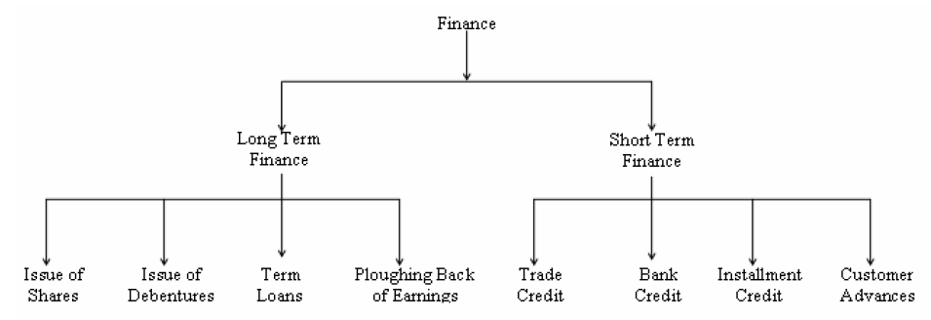
Sources of Finance
One of the major functions of financial management is determining the financing mix for raising the required amount of capital to run the business. This requires a clear understanding of the available sources of money.

Slide 77
Issue of shares
The most important source of long term fund is issue of shares.
The company invites members of the public through its prospectus to purchase shares and the persons who purchase the shares are called share holders. The liability of the share holders is limited to their capital contributions and they are entitled to transfer shares.
As per the Indian Companies Act, 1956 a company can issue two classes of shares namely preference shares and equity (or) ordinary shares.

Slide 78
Issue of shares
Preference shares are those which carry a preference with regard to payment of dividend and repayment of capital in the event of winding up. The rate of dividend on a preference share is fixed and must be paid before any dividend is paid on other classes of shares.
Ordinary shares will not have any preferences and dividend on these shares is paid only after payment of dividend to preference share holders. The rate of dividend fixed on equity shares is not fixed and it may vary from year to year depending on the financial position of the company

Slide 79
Issue of Debentures
A debenture is an acknowledgement of debt issued under the seal of the company.
Debentures are issued by the company when it wants to raise the money without increasing its share capital.
There are many differences between a debenture holder and a share holder.
A share holder is a part owner of the company, but a debenture holder is only a creditor.

Slide 80
Issue of Debentures
A share holder does not receive any dividend unless the company makes a profit, but the debenture holder will receive the interest on money lent by him, whether or not the company has made a profit.
In the event of winding up of the company the amount to debenture holders must be paid back before any amount is paid to share holders.

Slide 81
Term Loans
Term loan refers to long term financial assistance that is generally repayable in more than one year but less than ten years.
They represent secured borrowings. The repayment of principal amount of the term loan plus interest is a statutory obligation irrespective of the financial position of the company.

Slide 82
Term Loans
The following factors are generally considered by the lending institution before granting a term loan.
Type of company
Type of technology to be adopted by the company
Location of the company
Goods and services required by the company and its availability
Projected demand of the output of the product concerned and the expected revenue
Managerial competence
Repayment capacity

Slide 83
Ploughing Back of Earnings
Under this system, the entire profit generated by the company will not be distributed among the share holders or owners, but a portion of it will be retained by the company to serve as a source of finance for expansion and growth of the concern.
This is also referred to as internal financing or self financing.

Slide 84
Trade Credit
This represents the credit granted by other firms or suppliers, usually for a period of thirty to ninety days.
Trade credit is usually granted to the company on the basis of its good will and also the financial position.

Slide 85
Bank Credit
This is an important source of short term finance and may be in the form of advances, loans, cash credits, overdrafts, etc.

Slide 86
Installment Credit
This type of finance is generally employed by the companies to purchase equipments and machinery and the payment is made on easy installments.

Slide 87
Customer Advances
Short-term financial requirements of the company, at least partly, can be met through customer advances.
These advances are obtained from the customers at the time of ordering or booking of the product and it represents a part of the product cost.
The period of such credit will depend upon the time taken to deliver the product.

Slide 88
Financial Accounting and Book-keeping
Financial accounting is concerned with external transactions i.e., it records all dealings with outside the concern.
Accounting is the summarization of the recorded information and analyzing and interpreting it for the use of the concerned parties to aid them in decision making.
Book-keeping is the making of routine records, individually and in groups, of financial transactions according to a set of rules.
Book-keeping is only a preliminary aspect of accounting.
Book keeping is also necessary in order to satisfy the income tax authorities.

Slide 89
Types of Accounts
Accounts can be of four types, namely:
Cash accounts – Cash receipts and payments
Real Accounts - accounts of assets or properties.
Personal Accounts - accounts in the names of persons, firms or companies
Nominal Accounts - related with elements such as wages, salaries, rent, commission, and interest.

Slide 90
Systems of Accounting
Two systems of accounting are in common use. They are:
The single entry system
The double entry system

Slide 91
Single entry system
Every transaction is between two persons or two concerns.
Every transaction, thus, affects two accounts.
Single entry system records only one side of the transaction and hence it does not provide complete information about a transaction.
This system of book keeping is not generally used.

Slide 92
Double entry system
Double entry system records both the sides of the transaction and thus provides complete information of the business transaction.
That is, it is based on the dual aspect concept – The credit side and the debit side
The double entry system of accounting is more scientific and is compulsory for joint stock companies in India.

Slide 93
The Journal
The Journal is a chronological record of business transactions.
The first record of a transaction is made in this book.
It is book of first or original entry in which transactions are recorded one after another, in the order in which they occur, showing:
date for each transaction
account and amount to be debited
account and amount to be credited, and
an explanation (if necessary).
The function of a journal is to provide a permanent and complete record, arranged in chronological order for future reference, of all business transactions of a firm.
Every page of a journal is numbered for future reference.

Slide 94
The Ledger
A group of accounts is known as a ledger.
After the transactions have been recorded in the Journal, the accounts are prepared in this book.
Ledger contains the same information (as given in journal) but properly arranged according to each person or firm it is related to.
The ledger, therefore, is a derived or secondary record.
The account contains two identical halves.
The left side of an account is known as the debit side and is for debit entries.
The right side of an account is known as the credit side and is for credit entries.
The process of transferring journal entries to the ledger is known as posting.

Slide 95
Trial Balance
If no book-keeping errors are made the total of the debit balances and credit balances in the ledger will be equal.
A list of ledger account balances prepared for proving the equality of debits and credits in the ledger on a certain date is called a Trial Balance.
Trial balance is used to test the equality of balances because at any time the debits and credits should be equal in value.

Slide 96
Cash Book
The cash book is the most important subsidiary book in any business concern.
It is used to record cash transactions.
When cash is received cash account is debited and when cash is paid cash account is credited in the journal.
All cash transactions are first entered in the cash book.
The cash book has two sides, a receipt side or debit side and a payment side or credit side.
All receipts of cash are entered on the debit side, while all payments of cash are entered on the credit side.

Slide 97
Inflation
Inflation refers to the general increase in the prices of goods and services.
It is measured as an annual percentage increase.
As inflation rises, every Rupee you own buys a smaller percentage of a good or service

Slide 98
1. Demand-pull Inflation
This type of inflation occurs when total demand for goods and services in an economy exceeds the supply of the same.
When the supply is less, the prices of these goods and services would rise, leading to a situation called as demand-pull inflation.
This type of inflation affects the market economy adversely during the wartime.

Slide 99
2. Cost-push Inflation
As the name suggests, if there is increase in the cost of production of goods and services, there is likely to be a forceful increase in the prices of finished goods and services.
For instance, a rise in the wages of workers would raise the unit costs of production and this would lead to rise in prices for the related end product.
This type of inflation may or may not occur in conjunction with demand-pull inflation.

Slide 100
3. Pricing Power Inflation
Pricing power inflation is more often called as administered price inflation.
This type of inflation occurs when the business houses and industries decide to increase the price of their respective goods and services to increase their profit margins.

Slide 101
4. Sectoral Inflation
This type of inflation takes place when there is an increase in the price of the goods and services produced by a certain sector of industries.
For instance, an increase in the cost of crude oil would directly affect all the other sectors, which are directly related to the oil industry.

Slide 102
Valuation of Stock
During product manufacturing, at different intervals of time, the materials that are needed for production will be withdrawn from the stores.
As these materials are made from purchases over a period of time and at different prices, it is not always easy to arrive at the actual cost of material being used.
The accounting method that a company adopts for valuing materials used on products can directly have an impact on the final accounts of a company.

Slide 103
1. First-In First-Out (FIFO)
This method assumes that the material that is purchased earliest is the first used.
For example, consider that at time T1, 200 kilograms of material is bought at a price of Rs. 50/kg. and 200 kilograms more at time T2 at Rs. 60 /kg.
FIFO states that if 200 kilograms of material is withdrawn at time T3, then the withdrawal from stock is valued at Rs. 50× 200 = Rs. 10000

Slide 104
2. Last-In First-Out (LIFO)
This method assumes that the material that is purchased latest is the first used.
200 kilograms of material that is withdrawn at T3 will be valued at Rs. 60× 200 = Rs.12000

Slide 105
3. Weighted Average
This method takes the weighted average of all the materials available at the store at the time of issue and then uses the average cost to determine the value of stock.
In the present example, the average cost of material would be calculated as = (200×50 + 200×60)/400 = Rs. 55/ kg.
Using this average cost, 200 kilograms that is withdrawn at T3 will be valued at Rs. 55× 200 = Rs. 11000

Slide 106
Effects of Inflation on Valuation of Stock
If prices were constant during the period, all three methods of valuation, namely FIFO, LIFO, and weighted average would produce the exact same result since each unit would have been purchased for an identical amount.
But, since prices usually change, each method will produce different results.
During periods of inflation, LIFO will generate a lower amount of gross profit and a lower inventory value.
The FIFO method will produce a higher gross profit and a higher ending inventory balance.
During periods of inflation, LIFO offers substantial tax savings due to lower profits and lower inventories.
However, in periods of deflation, the effects are just the opposite.

Slide 107
Budget and Budgetary Control
Budgets are formal quantitative statements of the resources set aside for carrying out planned activities over given periods of time.
As such, they are widely used means for planning and controlling activities at every level of the organization.
In addition to being a major control device, budgets are one of the major means of coordinating the activities of the organization.
The interaction between managers and subordinates that takes place during the budget development process will help define and integrate the activities of the organization members.
There are a number of reasons for their wide range

Slide 108
Budget and Budgetary Control
First, budgets are stated in monetary terms, which are easily used as a common denominator for a wide variety of organizational activities – hiring and training personnel, purchasing equipment, manufacturing, advertising and selling.
Second, the monetary aspects of budgets means that they can directly convey information on a key organizational resource – capital – and on a key organizational goal – profit.
Third, budgets establish clear and unambiguous standards of performance for a set time period – usually a year. At stated intervals during that time period, actual performance will be compared directly with the budget. Deviations can be detected quickly and acted upon.

Slide 109
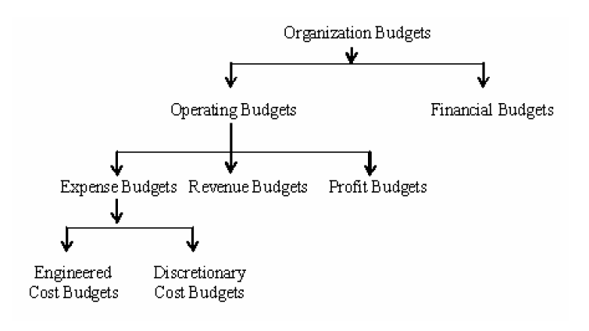
Budget and Budgetary Control

Slide 110
Budget and Budgetary Control
Operating Budget- Budget indicating the goods and services the organization expects to consume in a budget period
Financial Budget- Budget detailing the money expected to be spent during the budget period and indicating its sources
Expense Budget- Budget explaining where money was applied
Engineered Cost Budget- Type of expense budget that describes material and labour cost of each item produced, including estimated overhead costs

Slide 111
Budget and Budgetary Control
Discretionary Cost Budget- Type of expense budget that is used for departments in which output cannot be accurately measured
Revenue Budget- Budget for projected sales revenue, used to measure marketing and sales effectiveness
Profit Budget or Master Budget- Budget combining expense and revenue budgets in one unit

Slide 112
Elements of Cost
For the purpose of identification, accounting and control, breakup of cost into its elements is essential.
Costs are normally broken down into three basic elements, namely, material, labour and expense.
Material cost includes all materials consumed in the process of manufacture up to the primary packing.
Labour cost includes all remuneration paid to the staff and workmen for conversion of raw materials into finished products.
Expenses consist of the cost of utilities and services used for the conversion process including notional cost for the use of owned assets.

Slide 113
Elements of Cost
Each of the cost elements can be further divided into direct and indirect cost.
Direct costs are those which can be identified with or related to the product or services, so much so that an increase or decrease of a unit of product or service will affect the cost proportionately.
Indirect cost, on the other hand, cannot be identified or traced to a given cost object but are related to the expenses incurred for maintaining facilities for such production or services.
Thus, the elements of cost may be summarised as follows –
Direct materials and indirect materials
Direct wages and indirect wages
Direct expense and indirect expense.

Slide 114
Elements of Cost
The aggregate of direct materials cost, direct wages and direct expense is called Prime cost, while indirect materials cost, indirect wages and indirect expenses are collectively called overhead cost.
Overheads are classified into
production overheads i.e. indirect costs relating to manufacturing activities
administration overheads i.e. costs relating to formulating the policy, directing the organization and controlling operations and selling
Distribution overheads i.e. indirect costs relating to the activity of creating and stimulating demand and securing orders as well as operations relating to distribution of goods from factory warehouse to customers.

Slide 115
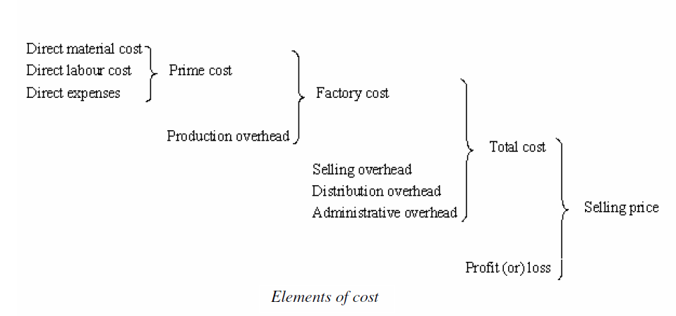
Elements of Cost

Slide 116
Allocation of Overheads
Manufacturing Costs or Operating Costs are equal to the direct production costs + fixed charges + plant overhead costs and the overhead cost refers to any costs not specifically or directly associated with the production of identifiable goods or services.
Therefore in order to calculate the total cost of the product it is necessary to assign the overhead to the product.
If an industry is making only one product, a uniform charge for overhead may be possible.
But if a number of different products are being manufactured, an equitable base must be sought out to charge each product with a fair and reasonable share of the overhead cost, so that the total cost of each unit may be calculated.

Slide 117
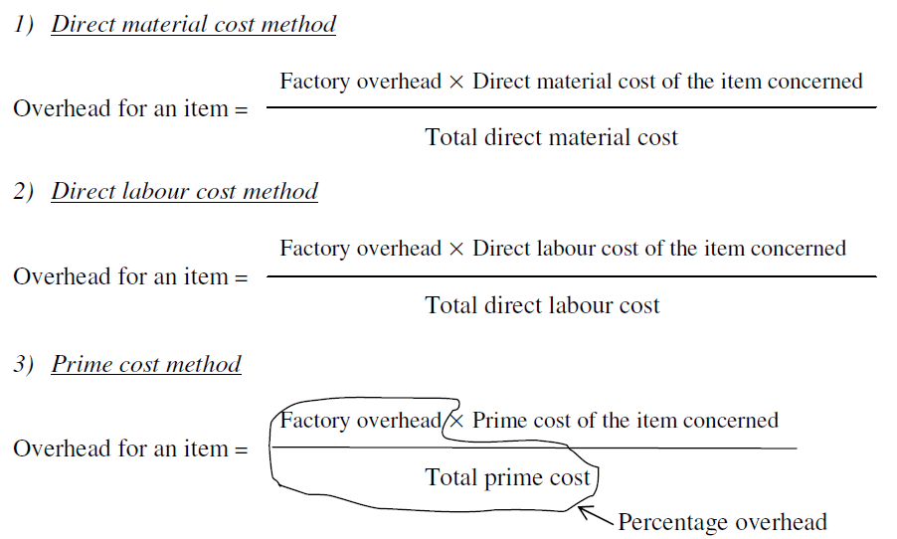
Allocation of Overheads

Slide 118
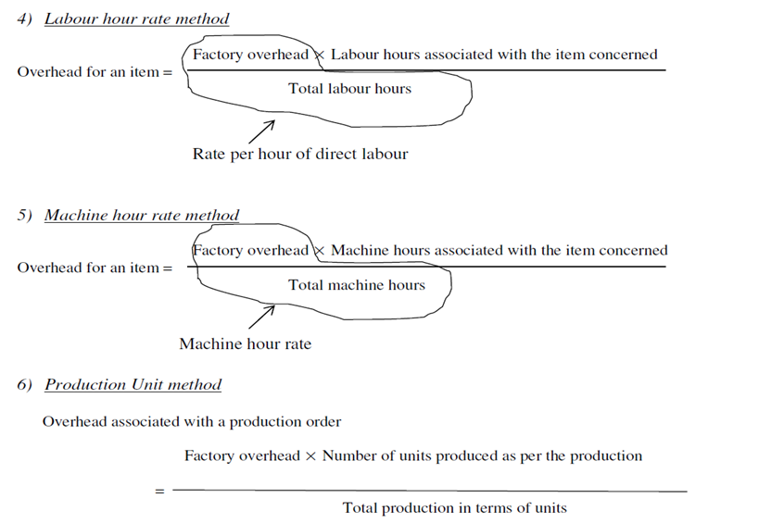
Allocation of Overheads

Slide 119
Standard Costing
Standard cost is defined as a predetermined cost which is calculated from management standards of efficient operations and the relevant necessary expenditure.
They are the predetermined costs on technical estimate of material, labour and overhead for a selected period of time and for a prescribed set of working conditions.
In other words, a standard cost is a planned cost for a unit of product or service rendered.

Slide 120
Standard Costing
The technique of using standard costs for the purposes of cost control is known as standard costing.
It is a system of cost accounting which is designed to find out how much should be the cost of a product under the existing conditions.
The actual cost can be ascertained only when production is undertaken.
The predetermined cost is compared to the actual cost and a variance between the two enables the management to take necessary corrective measures.

Slide 121
Marginal Costing
Marginal cost means the cost of the marginal or last unit produced.
It is also defined as the cost of one more or one less unit produced besides existing level of production.
The marginal cost of a product is its variable cost.
This is normally taken to be direct labour, direct material, direct expenses and the variable part of overheads.
Marginal costing technique has given birth to a very useful concept of contribution where contribution is given by: Sales revenue less variable cost (marginal cost)

Slide 122
Break Even Analysis

Slide 123
Break Even Analysis
Contribution may be defined as the profit before the recovery of fixed costs.
Thus, contribution goes toward the recovery of fixed cost and profit, and is equal to fixed cost plus profit (C = F + P).
In case a firm neither makes profit nor suffers loss, contribution will be just equal to fixed cost (C = F). This is known as break even point.

